Slide 1

Exploratory analysis Location recommendations
Steven L Truong
Friday, 02/04/2021

Slide 2


Slide 3

INTRODUCTION
MOTIVATION:
Greenwood LLC wants to expand their business and open the authentic Vietnamese restaurant in NYC.
They want to leverage Data Science and Analytics skills set to optimize their chance of success.
OBJECTIVES:
Determine the top stations with the most traffic.
Conclude the best location based on the volume of traffic and surrounding venues.
GOALS:
Logically and analytically present the results.
Notes:
Potential client offers opportunity to work with me.
Main objectives is to analyze the data to determine the top stations with the most traffic. Then, out of the top stations, deduce the most logical option based on not only the most crowded area, but also to answer the question that: what are the common venues around the neighborhood? Is it suitable to open the Vietnamese restaurant here?
Main goals: Using data science tools and analytical skills to extract useful information from raw data and logically present it to the client.

Slide 4









methodology
Data source:
MTA Turnstile Data
Square API
Tools:
SQL, Numpy and Pandas
Matplotlib and Seaborn
Folium, wordcloud, requests
Notes:
The main data source we will focus on is the MTA Turnstile data.
We also use Square API to explore surrounding venues of each station.
The tools we use are :
SQL for data storage and ingestion
Numpy and Pandas for data cleaning and manipulation
Matplotlib and Seaborn for plotting and visualizing
Other libraries: folium (map rendering), wordcloud (wordcloud generating), requests (handling url requests)

Slide 5
methodology
Exploration
Pull turnstile data from the source (MTA website)
Use Square API to pull data in json format into local machine for further analysis
Preparation
Clean raw data
Converse data from json to regular pandas dataframe
Visualization
Create graphs (time series, bar charts)
Generate NYC map with traffic density and venues wordclouds
Notes:
Exploration:
We will pull the most recent 4 months of data (particularly from 11/28/2020 to 03/27/2021) and use SQL to ingest into jupyter notebook to clean and analyze.
Use Square API to pull data in json format into local machine. We are interested in the density of venues around the neighborhood (such as how many restaurants there are around this particular neighborhood; if so, what kind of cuisine are they? Are they Korean, Italian, American or Vietnamese?...) Is this block specialized in pizza? (You know Nyers love pizza, so they wouldn’t go to pizza block to try Vnese rest)
Preparation:
Almost every dataset is messy, so before going into graphing and seeking insights, we have to clean it. (Like dropping duplicates, change the datatypes, etc…)
Json (JS Object Notation) format is dictionary-like type of object, so we have to converse them into regular (tabular) dataframe to be consistent with our purpose.
Visualization:
We will be using tools in our disposal to create graphs (time series and bar charts) to see the trend of the data, and seek insights from them.
We also generate NYC map with traffic density and the venues wordclouds.

Slide 6
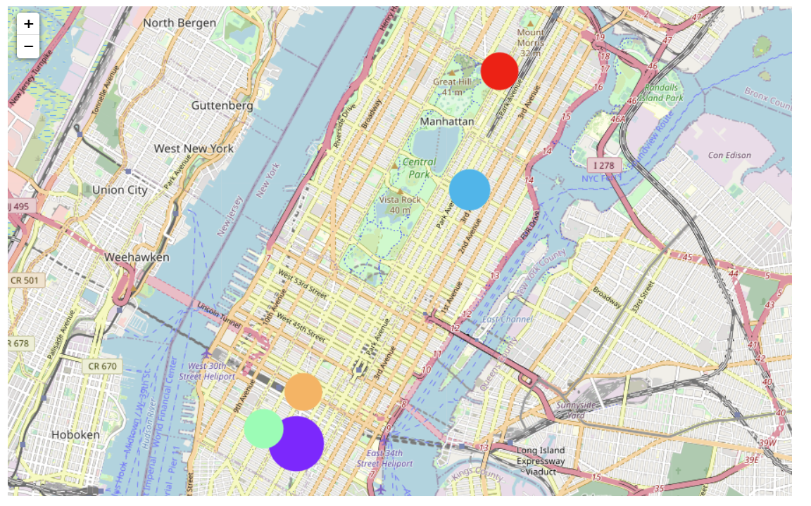
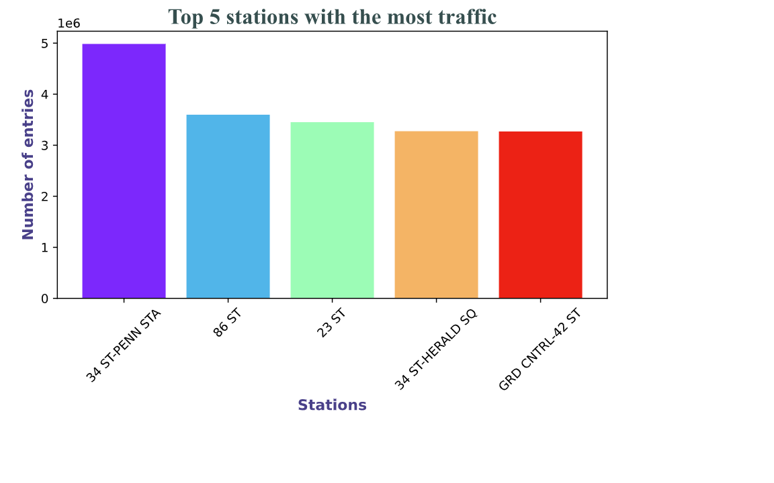
RESULTS
Top 5 stations with the most traffic:
34 St - Penn Station (near Korean town - Manhattan)
86 St Station (Upper East Side - Yorkville)
23 St Station (near Korean town - Manhattan)
34 St - Herald Square Station (near Korean town - Manhattan)
Grand Central - 42 St Station (near Korean town - Manhattan)
Notes:
For our business’ purpose, we only focus on the traffic between 8AM-10PM since we want to open the restaurant, and it’s not very applicable to investigate the traffic from midnight to the early morning.
And the results we got: here are the top 5 stations with the most traffic presented by both color-coded bar chart and map.
If we look at the map, the bigger the circle, the more traffic that station has.
Here is the 34st – Penn Station with almost 5 millions turns, followed by 86 with a little over 3.5 million.

Slide 7
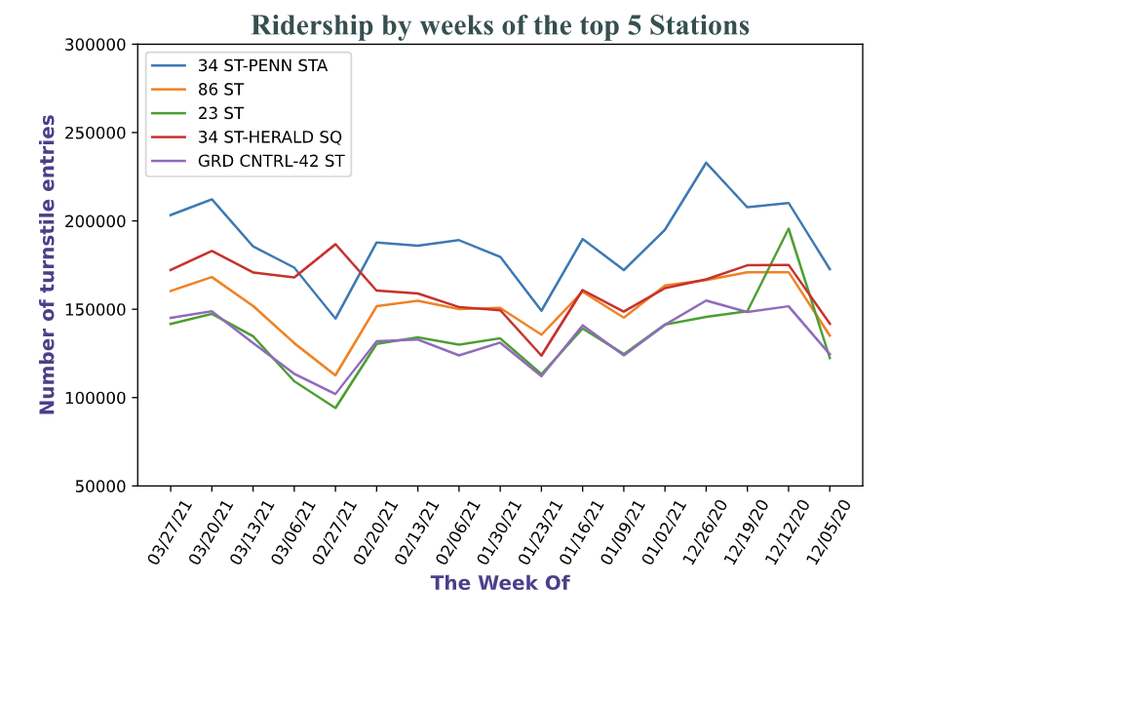
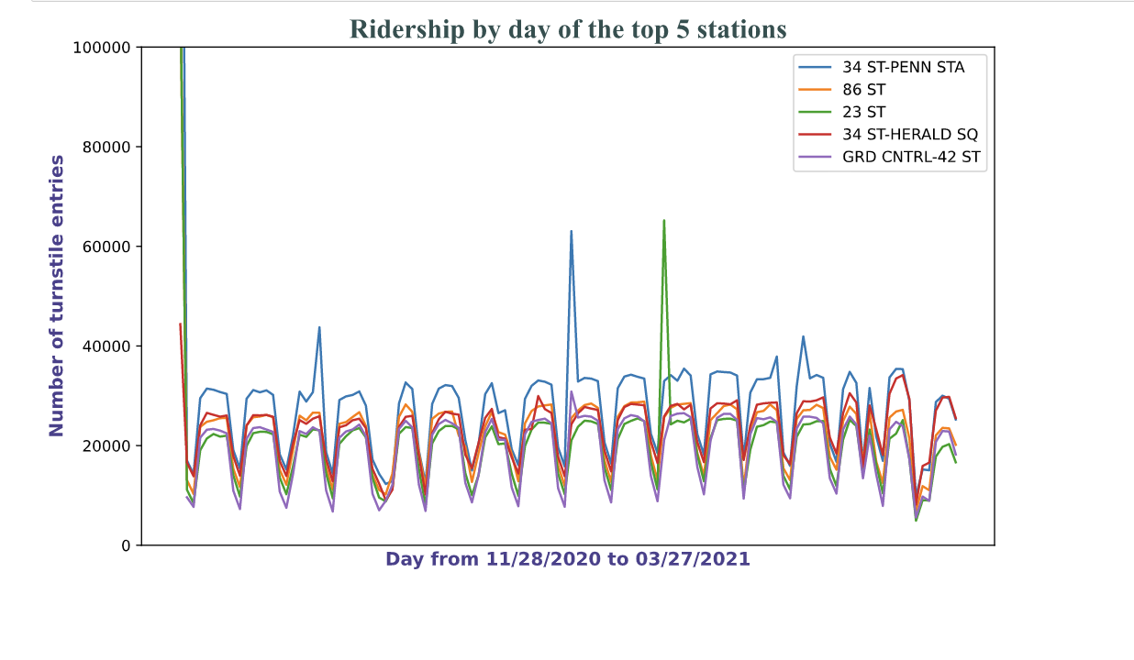
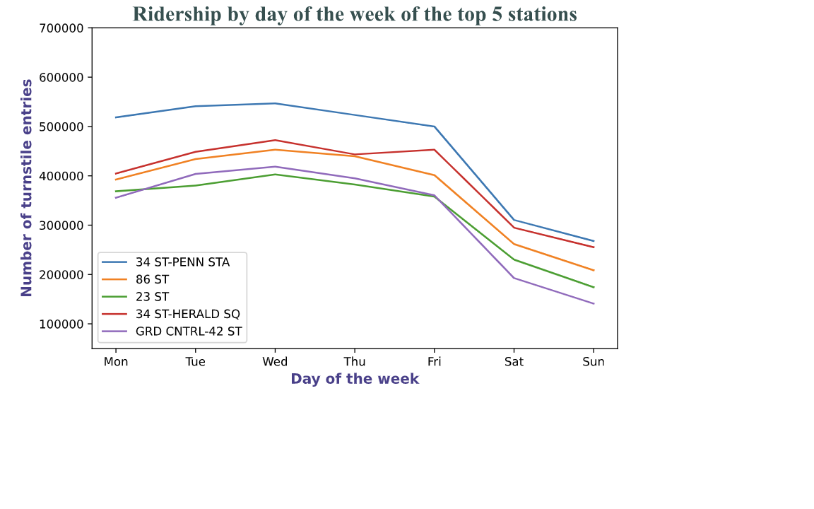
RESULTS
Notes:
Here are the time series charts of the top 5 stations broken down into 3 categories: ridership by day, ridership by week, and ridership by day of the week. Over, the trends of all 5 stations behave almost the same: high on weekday and low on weekend. (see fig3). There are some peeks (possible outliers) that are needed to be investigated more

Slide 8
RESULTS
What about each neighborhood’s nearby venues? Are there already lots of Vietnamese restaurants? Does the demand still need the supply?
Notes:
So I use Square API to pull each neighborhood’s nearby venues to investigate more. And here is the results I got.

Slide 9
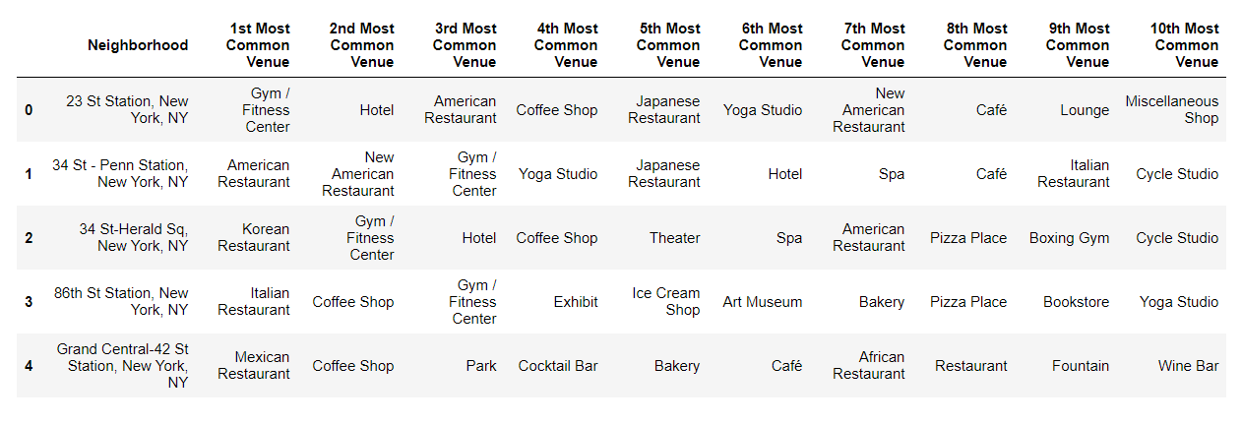
DISCUSSION

Slide 10
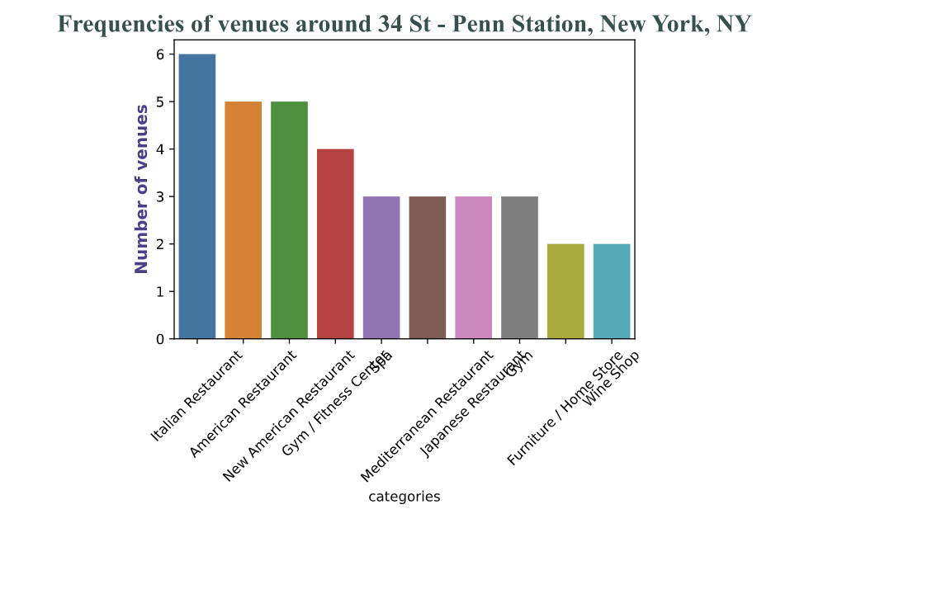
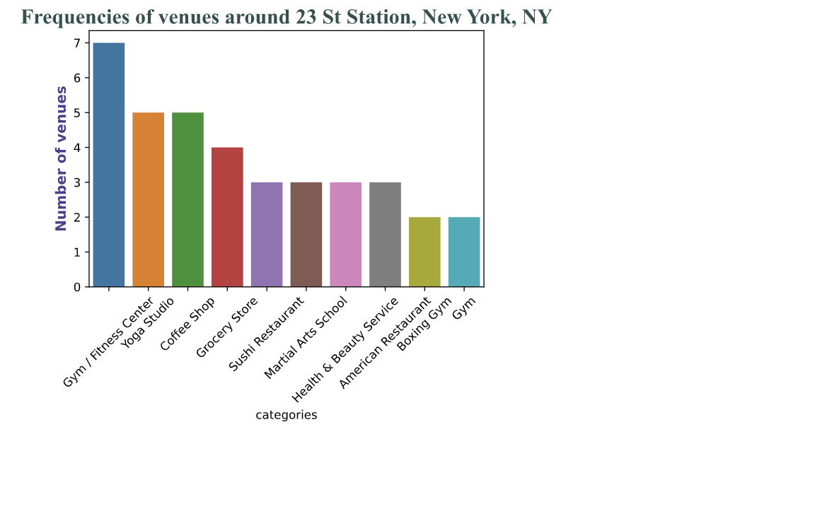
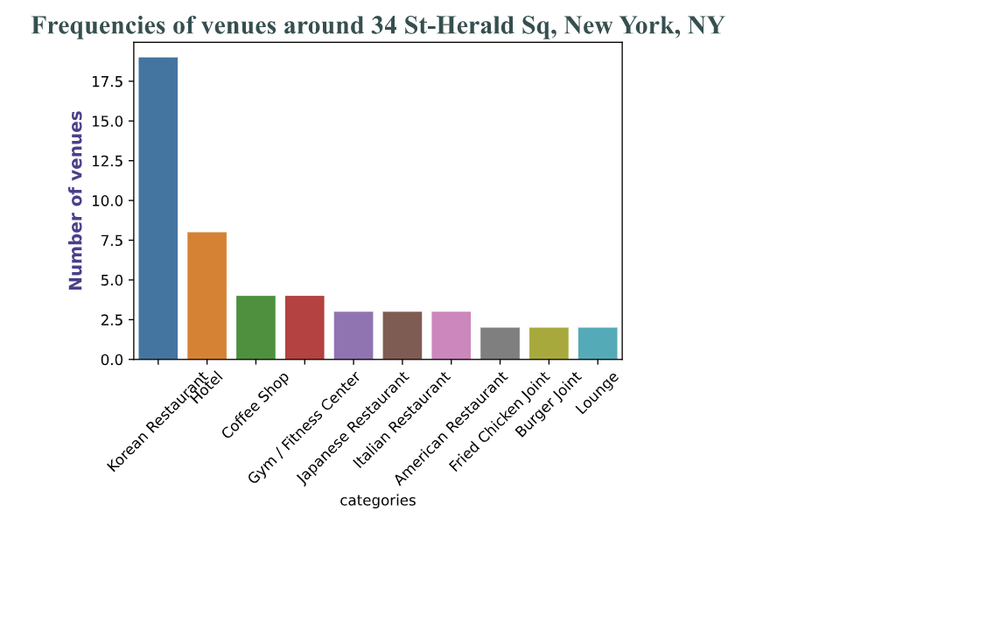
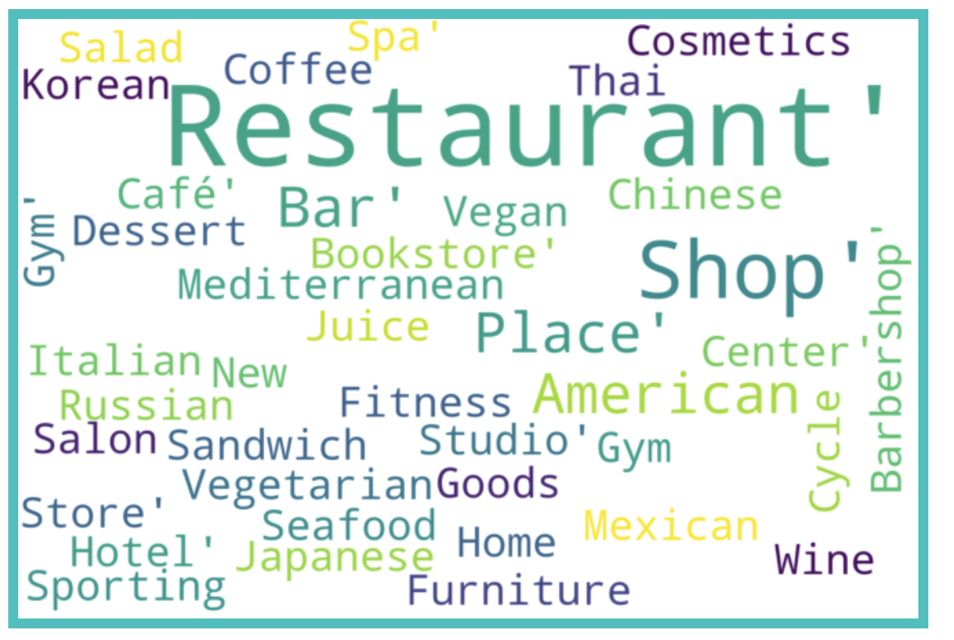
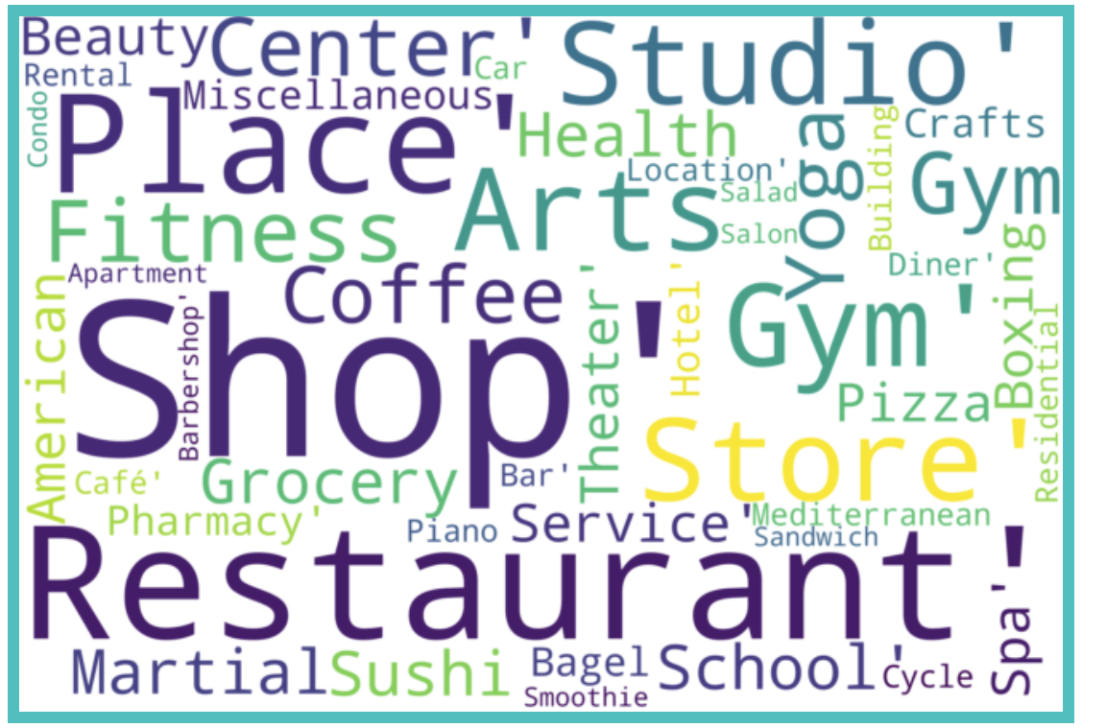
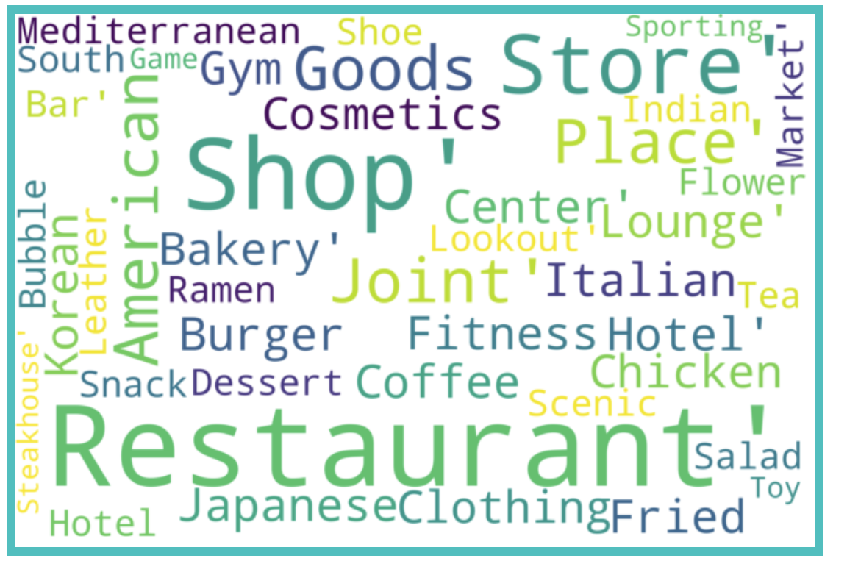
DISCUSSION
Nearby venues of 34 St – Penn station, 23 St station and 34 St- Herald Sq station.

Slide 11
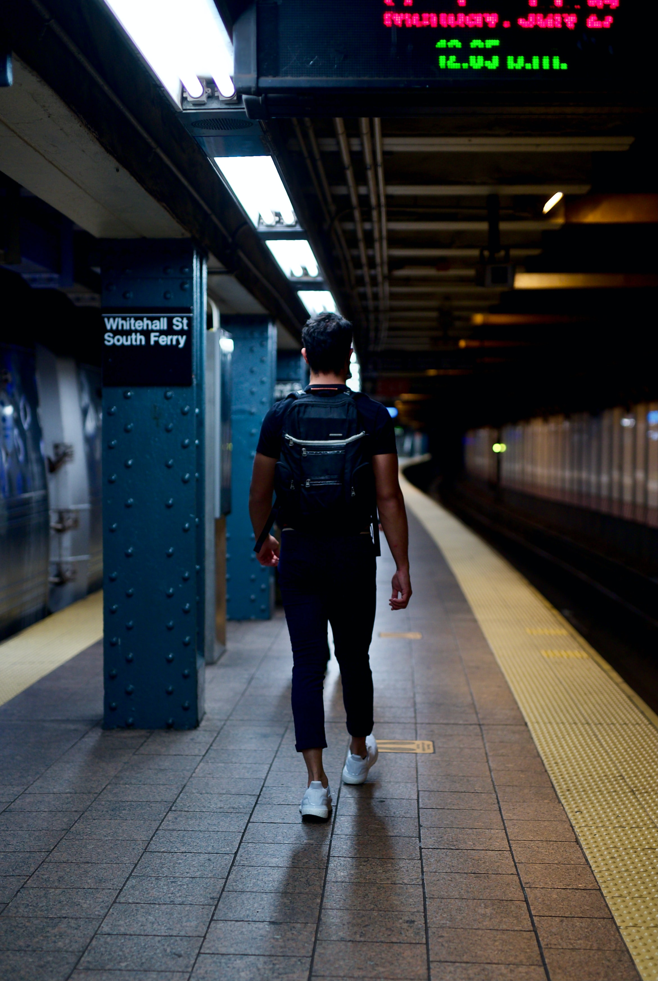
Conclusion
The 34 St – Penn Station and the 34 St – Herald Sq neighborhoods have many restaurants around them => not very suitable to open another one.
Recommendation: neighborhood around 23 st station.

Slide 12
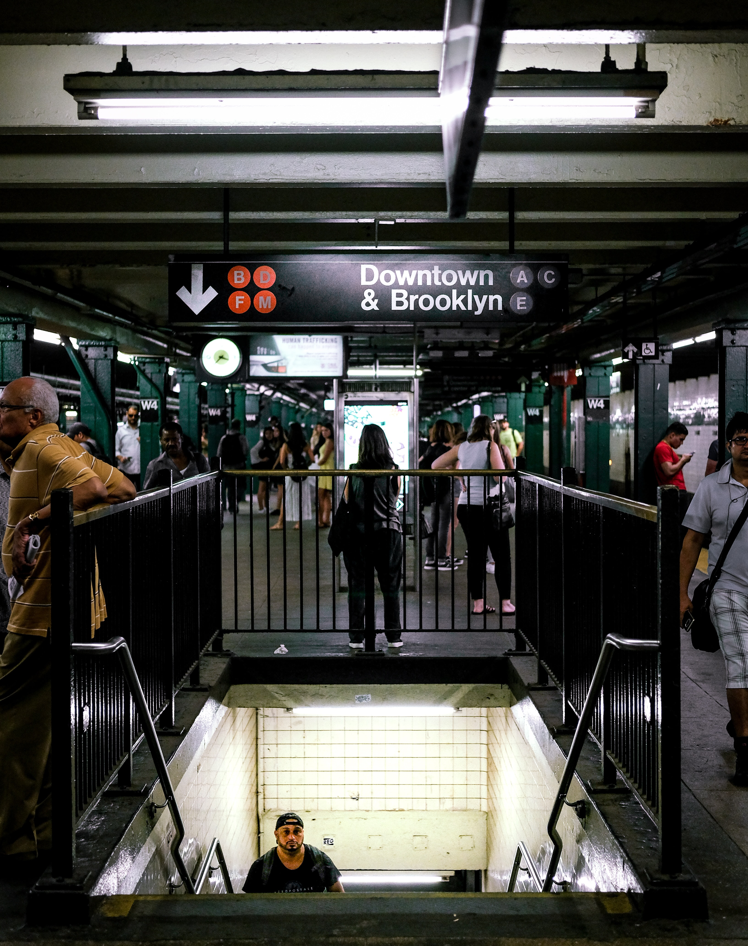
FUTURE WORK
Focus more on the neighborhood’s demographic.
Incorporate other data sources (such as crime rates or median income of certain population) to help shaping the results based on the business’ targeted customers.
Investigate customers’ behaviors to see whether they are affected by covid.

Slide 13



THANK YOU
Questions?
STEVEN L TRUONG
https://github.com/luongtruong77
tqluong77@gmail.com

Slide 14
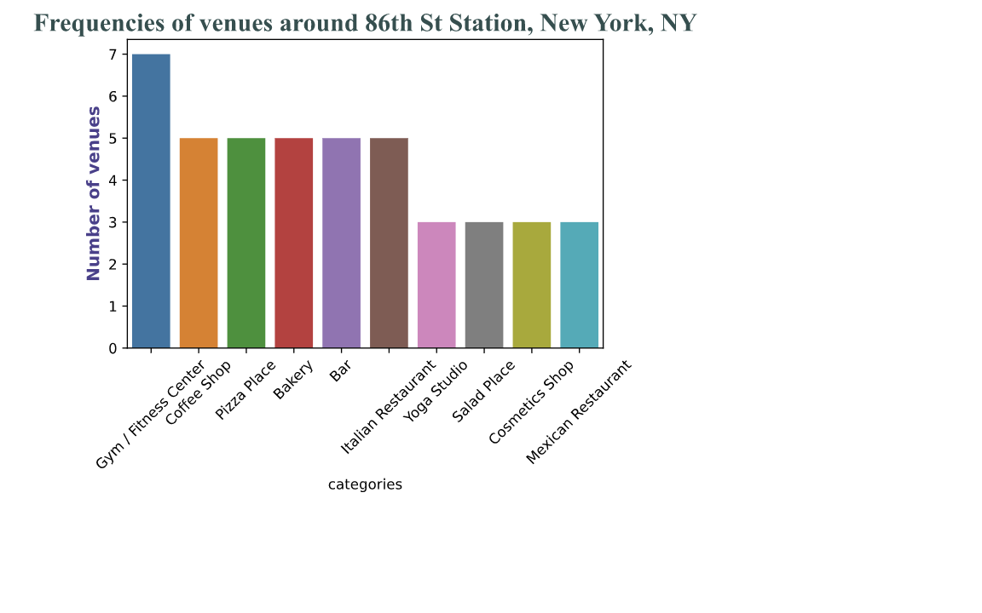
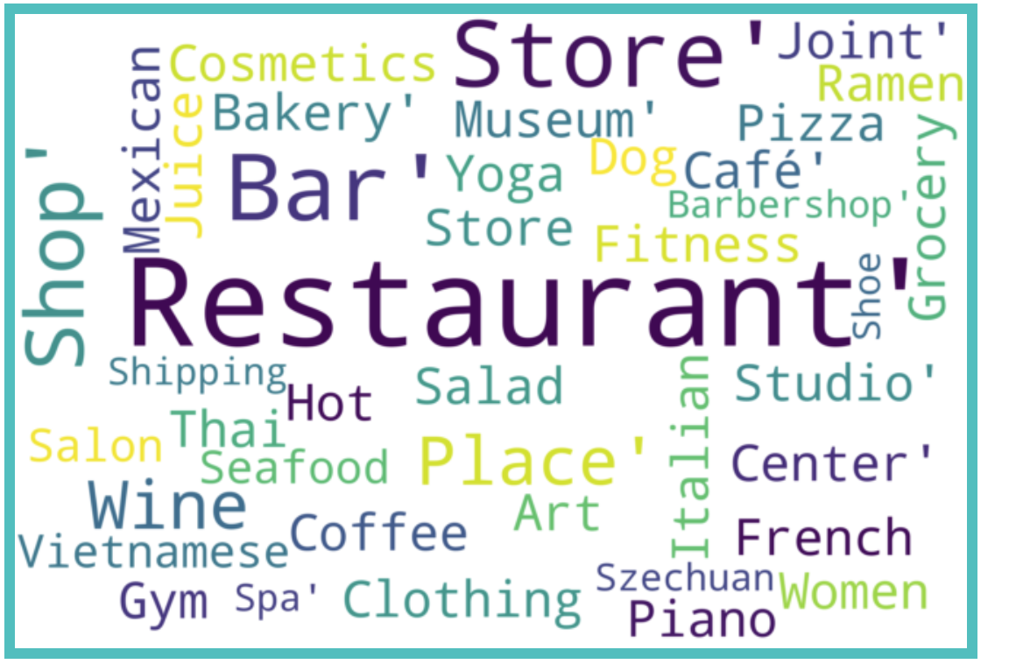
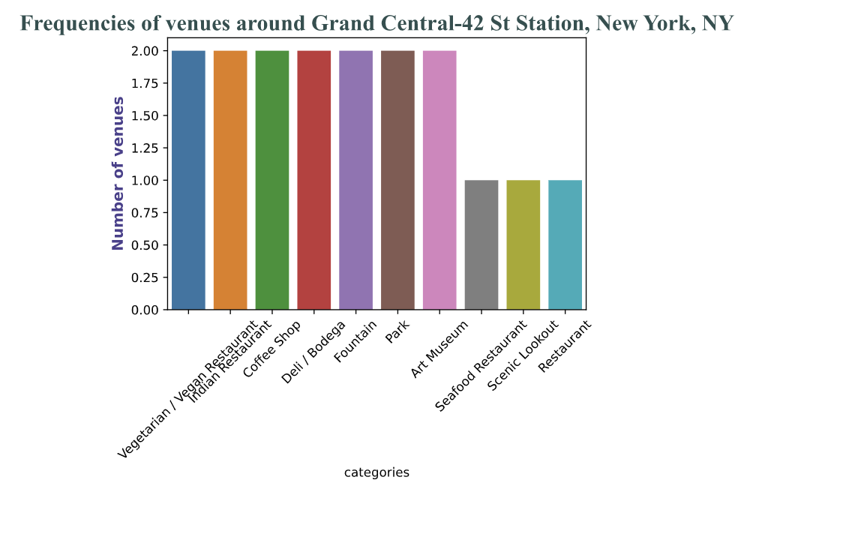
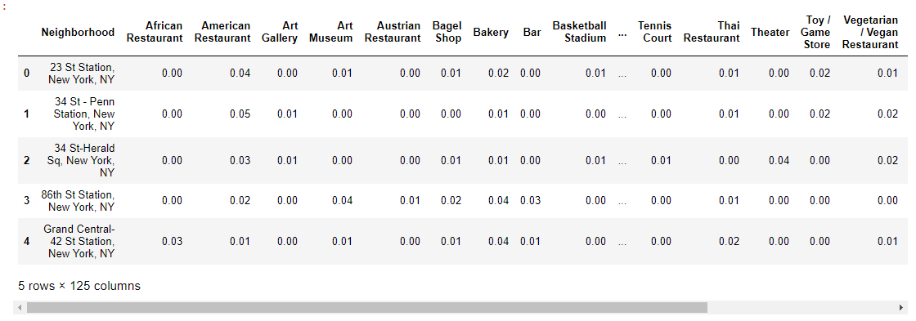
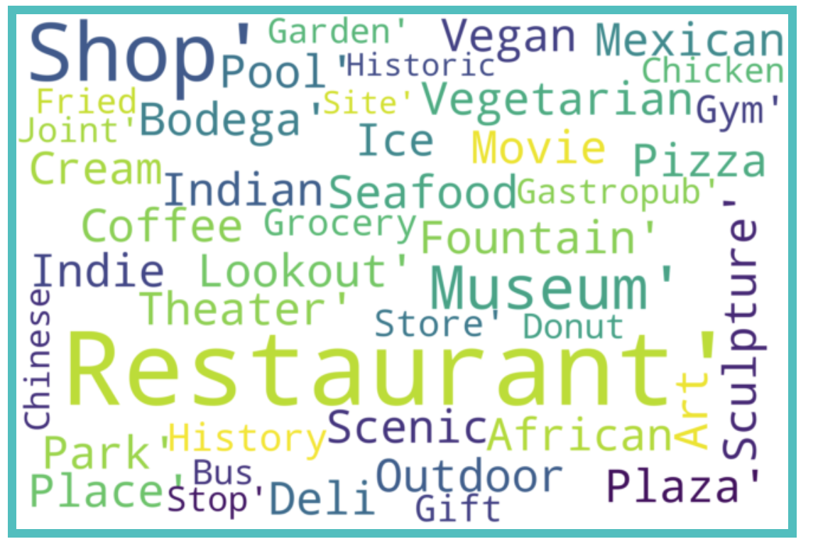
APPENDIX
Bar plots for the other 2 top stations along with their word clouds
Table of the 10 most common venues around top 5 stations

Slide 15
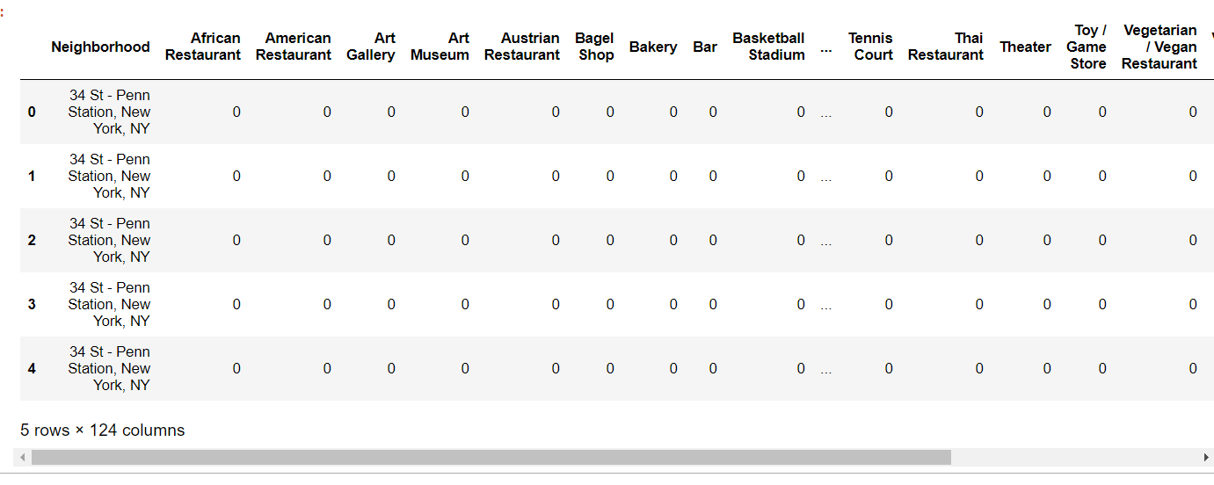
APPENDIX
First few rows of one hot encoding the neighborhood for each station
Documentation on how to use Square API to explore nearby venues given the neighborhood’s coordinates (latitude and longitude): https://developer.foursquare.com/docs/api-reference/venues/explore/

